Slide 1
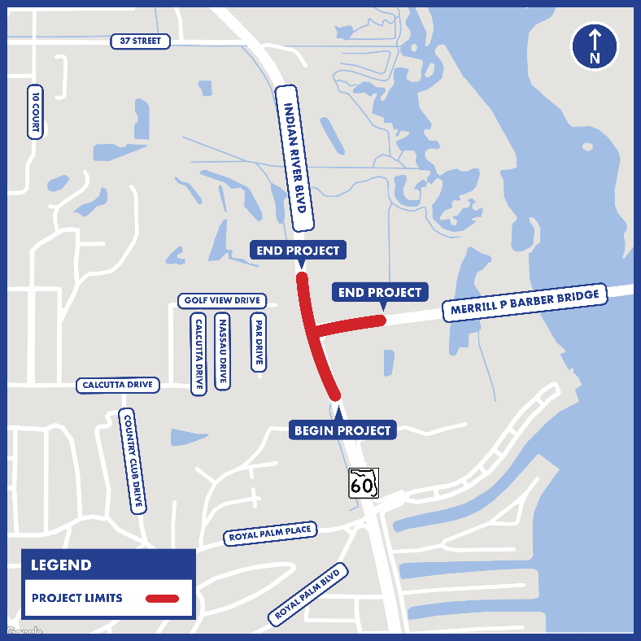
State Road 60/Indian River Boulevard from North of Canal Bridge to West of Merrill P. Barber Bridge - FPID: 449323-1-52-01
Public Meeting
June 27, 2023
THE PRESENTATION WILL BEGIN AT 5:30 P.M.
1

Slide 2
State Road 60/Indian River Boulevard from North of Canal Bridge to West of Merrill P. Barber Bridge - FPID: 449323-1-52-01
Public Meeting
June 27, 2023
2
Notes:
(Haiyan)
Good evening, and welcome to the Florida Department of Transportation design public meeting for proposed improvements to State Road 60/Indian River Boulevard from the Bridge over the Main Relief anal to north of SR 60 Merrill P. Barber Bridge. FPID: 449323-1-52-01. My name is Haiyan Ou. I am the FDOT Project Manager for the project. I would now like to introduce tonight’s moderator, Community Outreach Specialist, Lauren Hatchell.

Slide 3
Introductions
3
Notes:
(Lauren)
Slide 3

Slide 4
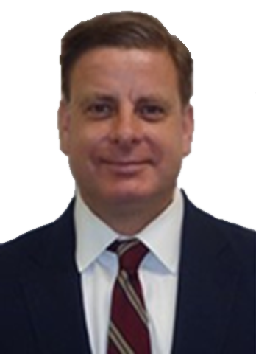
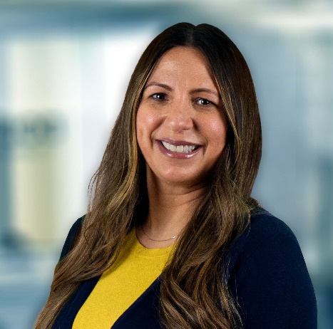
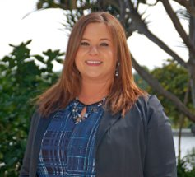
Meet the Team
Haiyan Ou, P.E.
FDOT Project Manager
FDOT Design Office
Billy Canedo
FDOT Communications
Manager
Kathy Lajo, P.E.
Consultant Project Manager
BCC Engineering
Lauren Hatchell
Community Outreach Specialist
Media Relations Group, LLC
4
Notes:
(Lauren)
Slide 4
Thank you, Haiyan.
At this time, I would like to introduce the project team:
Haiyan Ou, P.E. , FDOT Project Manager
Kathy Laio, P.E., Consultant Project Manager
Billy Canedo, FDOT Communications Manager
Lauren Hatchell, Community Outreach Specialist
If there any elected officials in attendance tonight, I invite you to introduce yourselves at this time. For those attending virtually, you may use the “Raise Hand” feature on the control panel to be called upon or state your name and title in the Question Box.

Slide 5
Agenda
General Information
Non-Discrimination Policy and Rules of Engagement
Project Location and Overview
Proposed Improvements
Temporary Traffic Control Plan
Project Schedule and Cost
Questions and Answers
Closing and Contact Information
5
Notes:
(Lauren)
Slide 5
Tonight’s agenda includes an overview of:
General Information regarding the public meeting,
FDOT’s Non-Discrimination Policy, and the
Rules of Engagement
A presentation about the project including the:
Location and Overview,
Proposed Improvements ,
Temporary Traffic Control Plan , and the
Project Schedule and Cost
Followed by the public comment portion of tonight’s meeting before we adjourn.

Slide 6
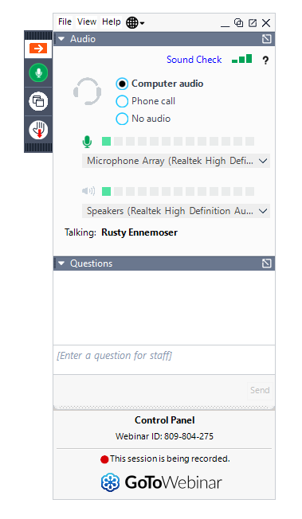
GoToWebinar Control Panel
6
Notes:
(Lauren)
Slide 6
Tonight’s meeting is being recorded.
We are using the GoToWebinar platform for tonight’s meeting at no cost to the public to participate.
The GoToWebinar Control Panel should be visible in the upper-right corner of your computer screen.

Slide 7
For Dial-In by Phone Attendees
If you requested or downloaded the presentation
Dial-in attendees are ‘listen only’
“Now showing slide 4.”
Paper copy of presentation
Presenter will indicate slide number
FDOT Treasure Coast Construction - State Road 60 Roadway Improvements (d4fdot.com)
7
Notes:
(Lauren)
Slide 7
If you dialed in today on a telephone line and arranged for a paper copy of the presentation, the presenter will announce the page number of the slide being shown.
The presentation is available on the project webpage at:

Slide 8
To report a technical issue…
Type in
Question box on GoToWebinar Control Panel
Send an email to manny@graph-code.com
Call
(786) 352-4351
?
8
Notes:
(Lauren)
Slide 8
If you experience technical difficulties during tonight’s meeting, you may:
Type the issue in the Question box on the control panel to report it.
Send an email to: manny@graph-code.com
Or call 786-352-4351
Staff will do their best to assist you.

Slide 9
Written Comments and Questions
Project Website
Multiple ways to submit:
Online using GoToWebinar
Type your comment/question in the Question box
Online at project website
By email to Project Manager
By U.S. mail to Project Manager
FDOT Treasure Coast Construction - State Road 60 Roadway Improvements (d4fdot.com)
Project Manager Contact Information
Haiyan Ou, P.E.
Florida Department of Transportation
3400 West Commercial Boulevard
Fort Lauderdale, FL 33309
(954) 777-4641
Haiyan.Ou@dot.state.fl.us
9
Notes:
(Lauren)
Slide 9
You may submit written comments and questions:
Using the Question box on the GoToWebinar Control Panel
Online on the project website at:
You can also email or mail your comments and questions to the project manager directly.
The project manager’s contact information will be spelled out towards the end of the presentation for the benefit of our listen-only attendees.
The contact information is also available on the public meeting notification that you may have received by mail.

Slide 10
Verbal Comments and Questions
Multiple ways to submit:
Online using GoToWebinar
Please unmute yourself when called upon
By phone, after the meeting
Haiyan Ou, P.E.
(954) 777-4641
10
Notes:
(Lauren)
Slide 10
You can also make verbal or spoken comments.
Online participants that requested to speak when registering will be called upon during the question-and-answer period of the public meeting.
If you did not request to speak earlier and wish to speak, use the Raise Hand button on the GoToWebinar Control Panel during the Public Comment Period.
When your name is called, you will need to unmute yourself on the GoToWebinar Control Panel before speaking.
Lastly, you can call the project manager at 954-777-4641 to provide verbal comments during normal business hours after the public meeting.

Slide 11
About Your Comments and Questions
All comments and questions are part of the Public Record.
Please submit your comments and questions by July 12, 2023
All registrants will receive a link to the meeting recording.
11
Notes:
(Lauren)
Slide 11
All public comments and questions are part of the Public Record.
If you plan to submit a comment or question after today’s public meeting, we ask that you do so by July 12, 2023.
The public meeting video link will be posted on the project website and a link to the video will also be provided by email to all persons that registered for the meeting.

Slide 12
Public Meeting - Public Notice
Property owner/tenant letters
Emails to project contacts list
Florida Administrative Register
Social media
12
Notes:
(Lauren)
Slide 12
Public notice for this Public Meeting, including information on how to access the meeting platform, was provided in letters to property owners and tenants in the project area, a posting in the Florida Administrative Register, on the project website, on social media feeds, and through other notification methods.

Slide 13
Project Documents
Draft project documents are available for public review at the following location and online.
Physical Location
Project Website
Florida Department of Transportation,
3400 West Commercial Blvd.
Fort Lauderdale, FL 33309
FDOT Treasure Coast Construction - State Road 60 Roadway Improvements (d4fdot.com)
13
Notes:
(Lauren)
Slide 13
Draft project documents are available for viewing at the Florida Department of Transportation, 3400 West Commercial Blvd., Fort Lauderdale, FL 33309
The draft project documents are also available on the project website at

Slide 14
Non-Discrimination Policy and Rules of Engagement
14
Notes:
(Lauren)
Slide 14

Slide 15
Title VI of the Civil Rights Act of 1964
Title VI Compliance
Public participation is solicited without regard to race, color, national origin, age, sex, religion, disability, or family status. Persons wishing to express concerns relative to FDOT compliance with Title VI may do so by contacting:
Sharon Singh Hagyan
District Four Title VI Coordinator
3400 West Commercial Boulevard
Fort Lauderdale, Florida 33309
954.777.4190
Sharon.SinghHagyan@dot.state.fl.us
Stefan Kulakowski
State Title VI Coordinator
605 Suwannee Street
Tallahassee, Florida 32399
850.414.4742
Stefan.Kulakowski@dot.state.fl.us
All inquiries or concerns will be handled according to FDOT procedure and in a prompt and courteous manner.
15
Notes:
(Lauren)
Slide 15
The Florida Department of Transportation complies with various non-discrimination laws and regulations including Title VI of the Civil Rights Act of 1964. Tonight’s meeting is being held without regard to race, color, national origin, age, sex, religion, disability or family status.
For questions or concerns, you may contact the Florida Department of Transportation’s Title VI Coordinators listed on the screen.

Slide 16
Rules of Engagement
This Public Meeting is being recorded.
If you experience technical difficulties, please contact 1-786-352-4351 so that a member of our technical support team may assist you.
All Virtual (online) attendees will remain muted throughout the Meeting.
Virtual (online) attendees are also welcome to submit any questions/comments using the GoToWebinar control panel at any time or use the “Raise Hand” button on your control panel and a member of our team will respond to/unmute you during the open discussion.
All in-person attendees are welcome to submit a question or comment by forming a line after the presentation, during the open discussion.
If you are participating via Telephone and have questions/comments, feel free to submit them to FDOT Project Manager Haiyan Ou, P.E. via email after the meeting and a response will be provided.
?
16
Notes:
(Lauren)
Slide 16
This Public Meeting is being recorded.
If you experience technical difficulties, please contact 1-786-352-4351 so that a member of our technical support team may assist you.
All Virtual attendees will remain muted throughout the Meeting.
Virtual attendees are also welcome to submit any questions or comments using the GoToWebinar control panel at any time or use the “Raise Hand” button on your control panel and a member of our team will respond to you during the open discussion.
All in-person attendees are welcome to submit a question or comment by forming a line after the presentation, during the open discussion.
If you are participating via Telephone and have questions/comments, feel free to submit them to FDOT Project Manager Haiyan Ou, P.E. via email after the meeting and a response will be provided.
I would now like to introduce Kathy Lajo, Consultant Project Manager, who will give a presentation on the project.

Slide 17
Project Location and Overview
17
Notes:
(Kathy)
Slide 17
Thank you, Lauren.
Good evening everyone, my name is Kathy Lajo, and I am the Consultant Project Manager for this project which will provide operational and safety improvements to the SR 60/Indian River Boulevard and Merrill Barber Bridge intersection located in Indian River County.
Next slide.

Slide 18
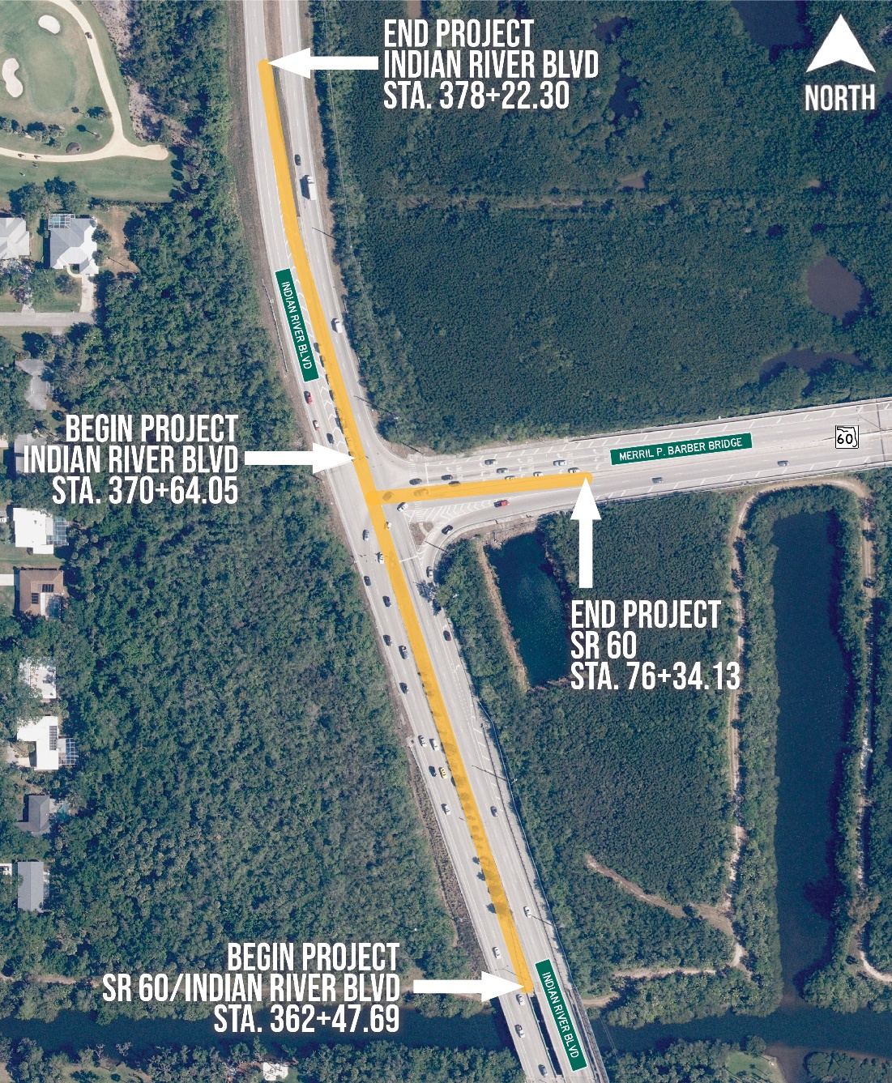
Project Limits
State Road (SR) 60/ Indian River Boulevard
from North of Canal Bridge to West of Merrill P. Barber Bridge
18
Notes:
(Kathy)
On this slide 18 you’ll see an aerial showing the project limits. SR 60/Indian River Blvd and Merrill Barber Bridge intersection is a T-intersection.
The Project limits consist of two segments: (1) SR-60/Indian River Blvd from just north of Canal Bridge (located at the bottom of the slide) to about 800 ft north of the intersection (for a total 1,575 ft); and (2) the east leg of the T instersection which starts at SR-60/Merrill Barber Bridge intersection and ends approximately 600 feet to the east of the intersection.
The total project length is 0.43 miles

Slide 19
Typical Sections
Notes:
(Kathy)
Slide 19
Typical Section: the following 3 slides present the typical sections of each leg of the intersection.

Slide 20
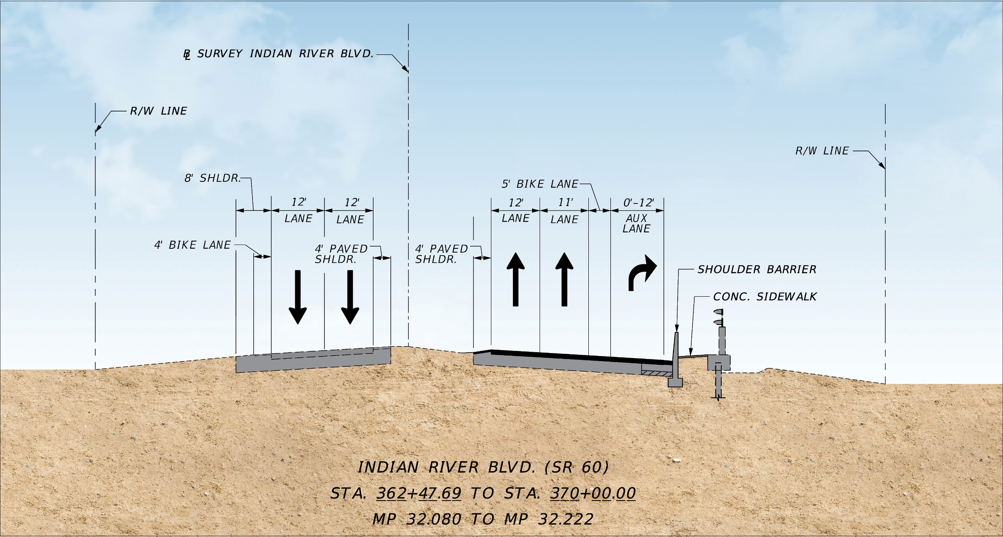
Typical Sections
Notes:
(Kathy)
Slide 20:
Slide 20 presents the typical section of the south leg as if you were driving northbound approaching the intersection (looking northbound).
From left to right:
- Southbound remains as in current condition ….. With a 4’ bike lane, 2-12’ lanes and a 4’ inside shoulder
- Northbound: will be widened to increase the NB right turn lane. Typical will consist of:
a 4’ paved inside shoulder
2 travel lanes (12’ and 11’)
A 5’ bike lane; and
A 12’ right turn lane
With a shoulder barrier wall separating the sidewalk

Slide 21
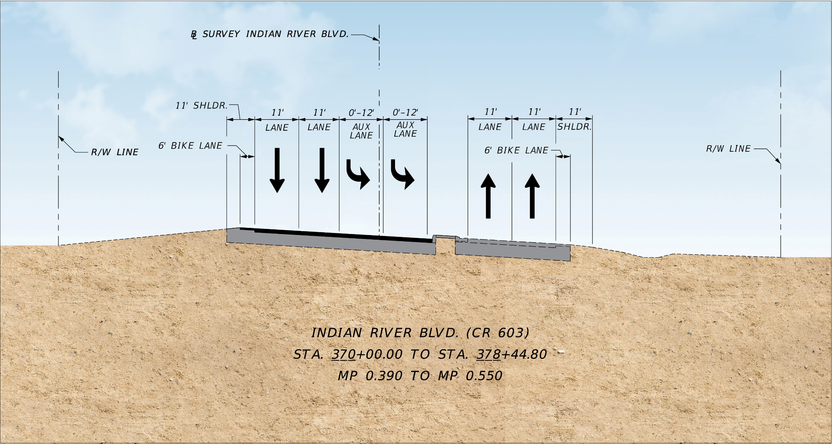
Typical Sections
Notes:
(Kathy)
Slide 21 presents the typical section of the north leg of the intersection. The typical section shown is as if you were looking north.
Southbound typical will be modified to provide the following within the existing pavement):
A 6’ bike lane,
2-11’ thru lanes,
and 2-12’ left turn lanes (added by removing chevroned area)
and a raised median.
Northbound: remains the same and consists of
2 - 11’ travel lanes
a 6’ bike lane

Slide 22
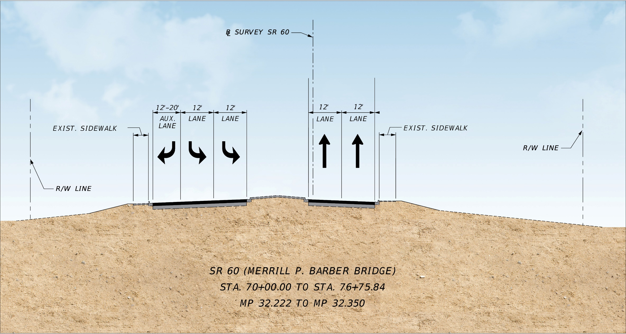
Typical Sections
Notes:
(Kathy)
Slide 22 presents the typical section of the east leg which is Merrill Barber Bridge approach as if you were looking east from the intersection.
From left to right:
Westbound:
includes a 12’ right turn lane to NB IRB
2-12’ left turn lanes to SB SR 60
Eastbound: includes 2-12’ lanes and exising sidewalk.

Slide 23
Proposed Improvements
Notes:
(Kathy)
Slide 23

Slide 24
Proposed Improvements
Signalize and extend the northbound right-turn lane
Convert the southbound striped-out lane to a second left-turn lane
Upgrade traffic signals and pedestrian push button countdown detectors
Upgrade lighting at the pedestrian crosswalk
Install green colored bike lane at northbound conflict location
Notes:
(Kathy)
Slide 24
This slide presents a summary of the proposed improvements at the intersection addressing safety and operational concerns of the intersection:
Widening to extend the NB right turn lane to increase storage capacity and signalizing the nb right turn movement.
Converting the striped out lane to a second southbound left turn lane onto Merrill barber bridge.
Upgrades traffic signals and upgrade pedestrian signals with push button countdown
Upgrade lighting at the pedestrian crosswalk.
Install green colored bike lane at conflict locations.
And now I’ll pass it over to Mr. Shaun Connor to provide additional details of the proposed improvements.

Slide 25
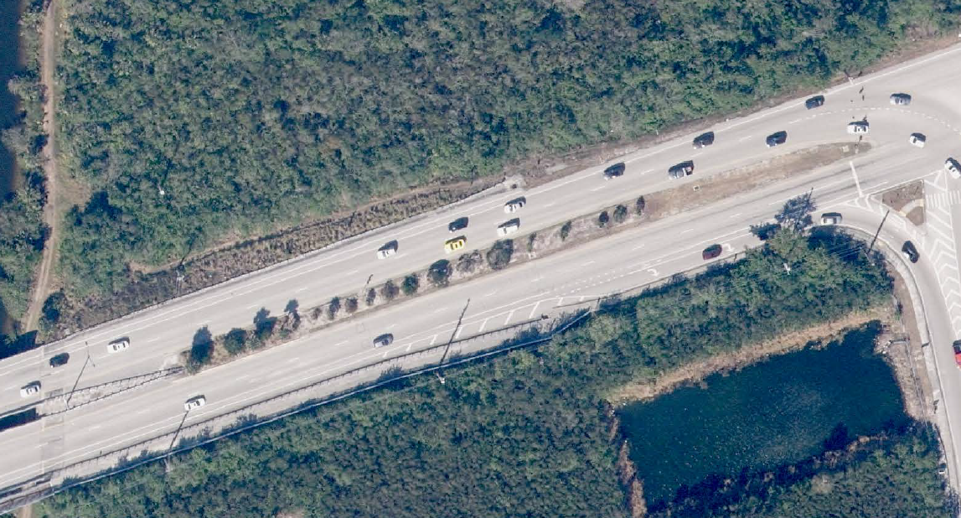
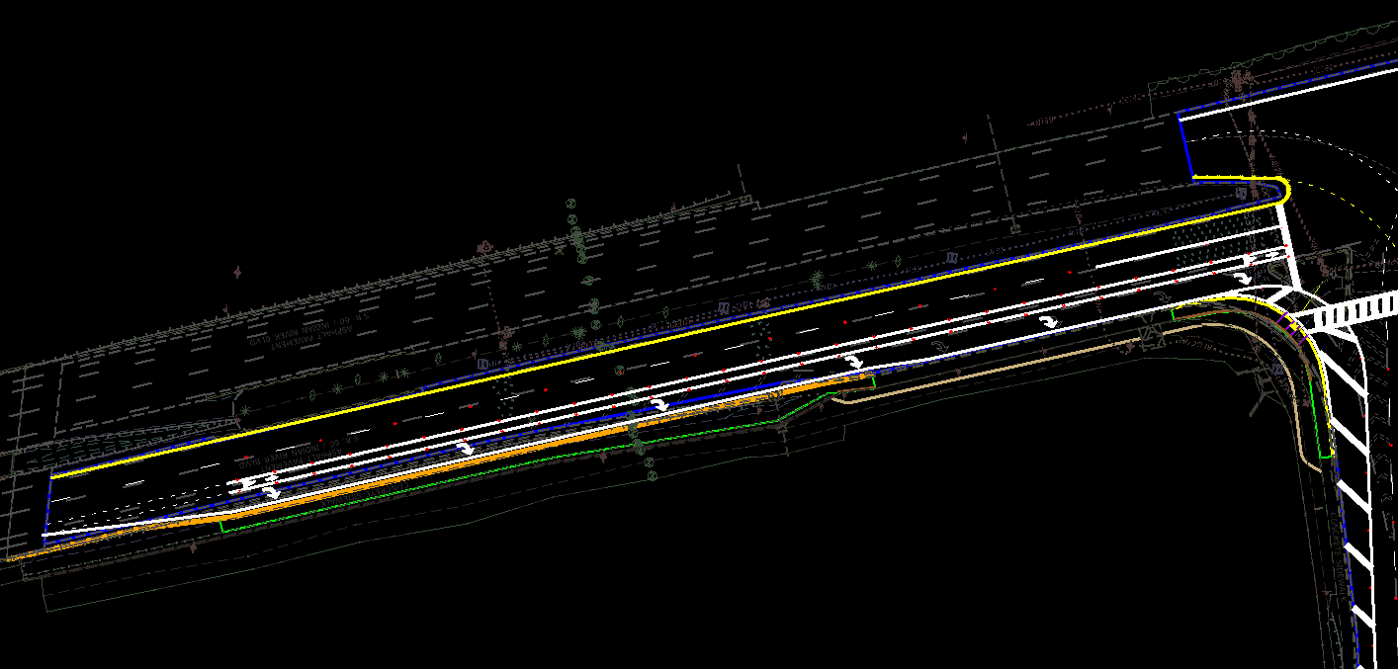
Existing NB Right turn lane
Northbound Right-turn Lane Improvements
N
N
Proposed NB Right turn lane
N
N
N
Notes:
(Shaun)
Slide 25
Good Evening. I’m Shaun Connor the Engineer of Record for the Project. On slide 25 you can see the comparison between the existing NB Right turn lane and the proposed NB Right turn lane.
Currently this is a free flow lane where the NB to EB traffic can turn right without signal direction. In the proposed condition, we will widen and extend the right turn lane from 160 ft to 500 ft to improve turn lane capacity,
remove the traffic island, and improve pedestrian safety by signalizing the right turn lane and reducing the crosswalk length for a more direct approach.
Next slide please

Slide 26
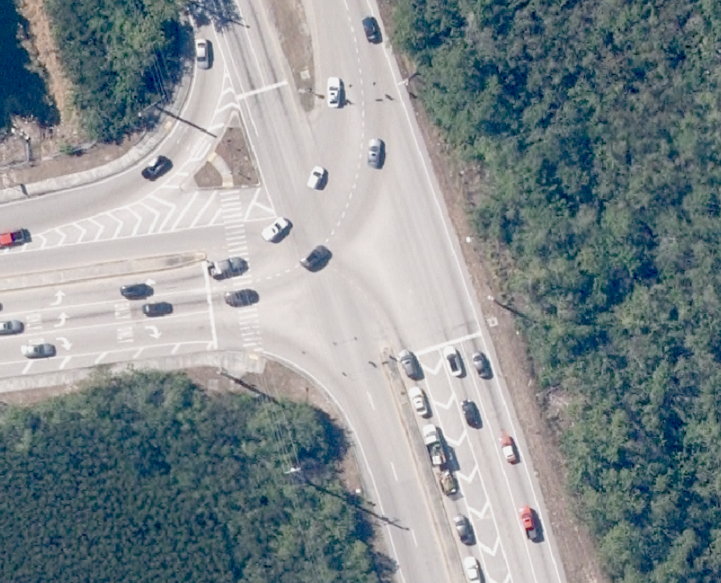
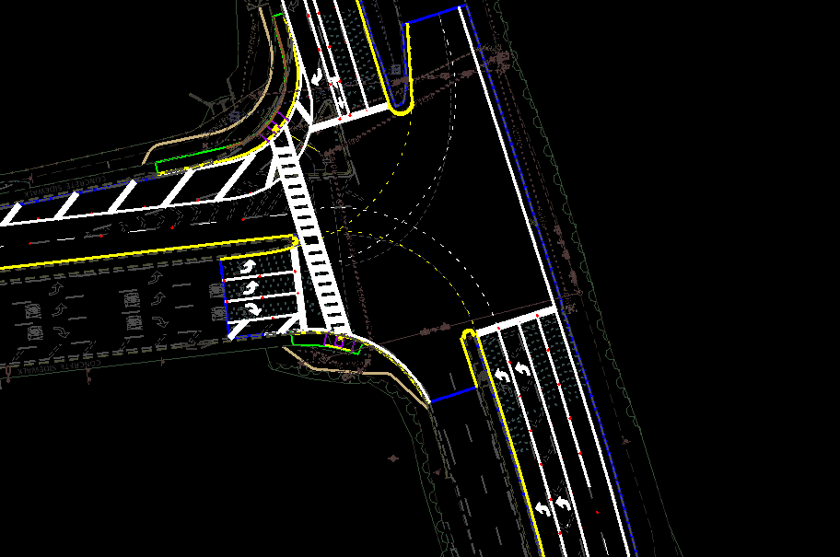
Southbound Left-turn Lane Improvements
Proposed SB Left turn lane
N
N
Existing SB Left Striped Out Lane
Notes:
(Shaun)
Slide 26
On slide 26 you can see the comparison between the existing SB Left turn lane and the proposed SB Left turn lane. The intersection in these images has been rotated so
The SB lanes are at the bottom and Marion Barber Bridge is to the left.
Currently the intersection only provides one SB to EB left turn lane at 320 ft. You can see on the image to the left where there is an existing striped out lane in the SB direction.
In the proposed condition, we will remove the striping and provide a second left hand turn lane to improve turning capacity at the intersection. This improvement will increase
The turning capacity from one 320 ft lane to two lanes with a combine length of 640 ft.
Next slide please

Slide 27
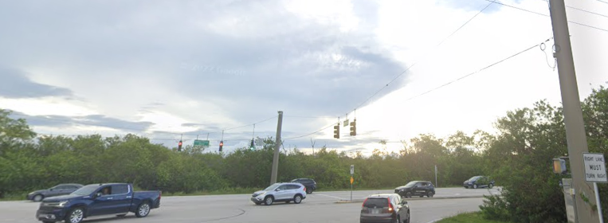
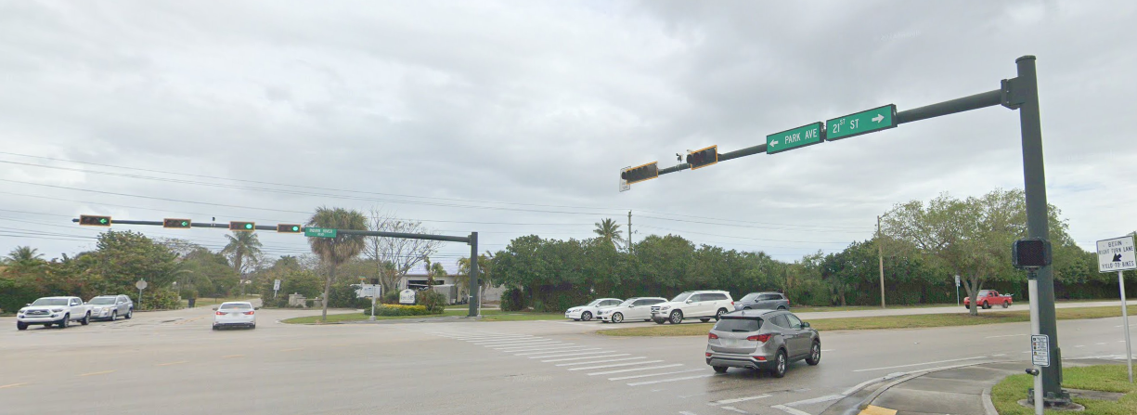
Signal Upgrades
Mast Arm Signal Upgrades
Existing Span Wire Signals
Notes:
(Shaun)
Slide 27
On Slide 27 you can see the image of the existing span wire signals at the top left. We will upgrade these signals to provide mast arm assemblies and pedestrian push buttons
similar to what’s shown at the bottom right. Upgrading the signals from span wires to mast arms will enhance safety in the event of hurricanes.

Slide 28
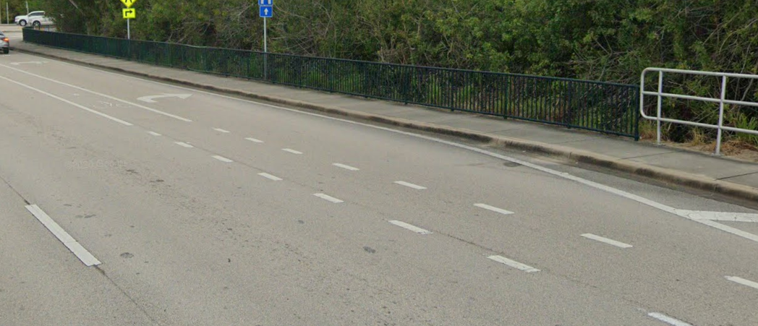
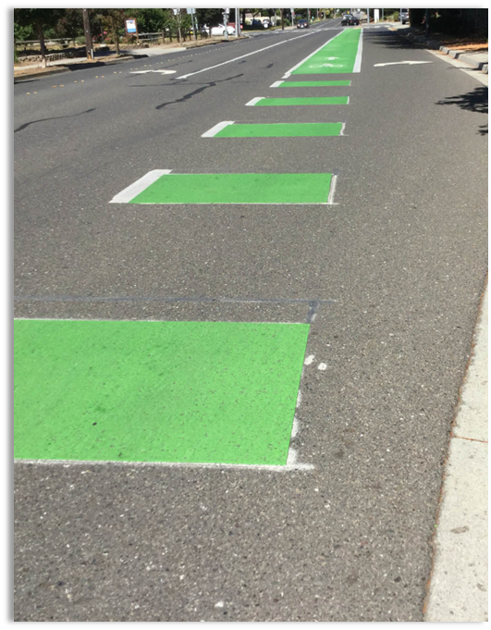
Green-colored pavement to increase driver awareness.
Installation of Green-Colored Bicycle Lanes (5’)
Existing NB bike markings at conflict location
Notes:
(Shaun)
Slide 28
The use of green-colored pavement will be installed at the conflict point in the northbound direction.
This improvement increases driver’s awareness and enhances safety.

Slide 29
Temporary Traffic Control
29
Notes:
(Shaun)
Slide 29
Temporary Traffic Control Plan

Slide 30
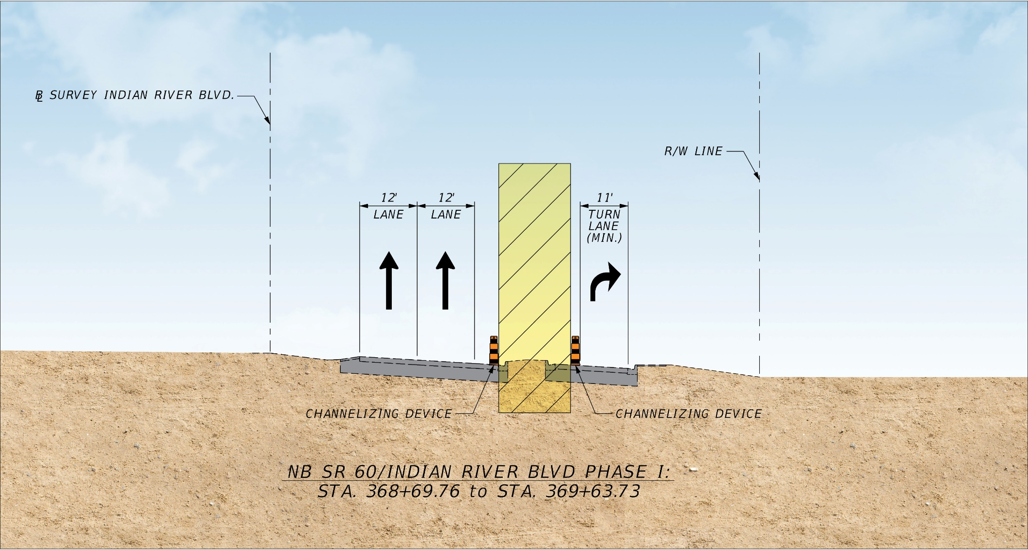
Temporary Traffic Control
Notes:
(Shaun)
Slide 30
Traffic Control will be provided in three separate phases at the intersection. On slide 30 you can see the temporary traffic control typical section for Phase I. The yellow hatched area on the slide represents the work zone during this phase. The work during this phase will include removal of the traffic island at the intersection. This work will be necessary to enable the work to continue for Phase II which is shown on the next slide.

Slide 31
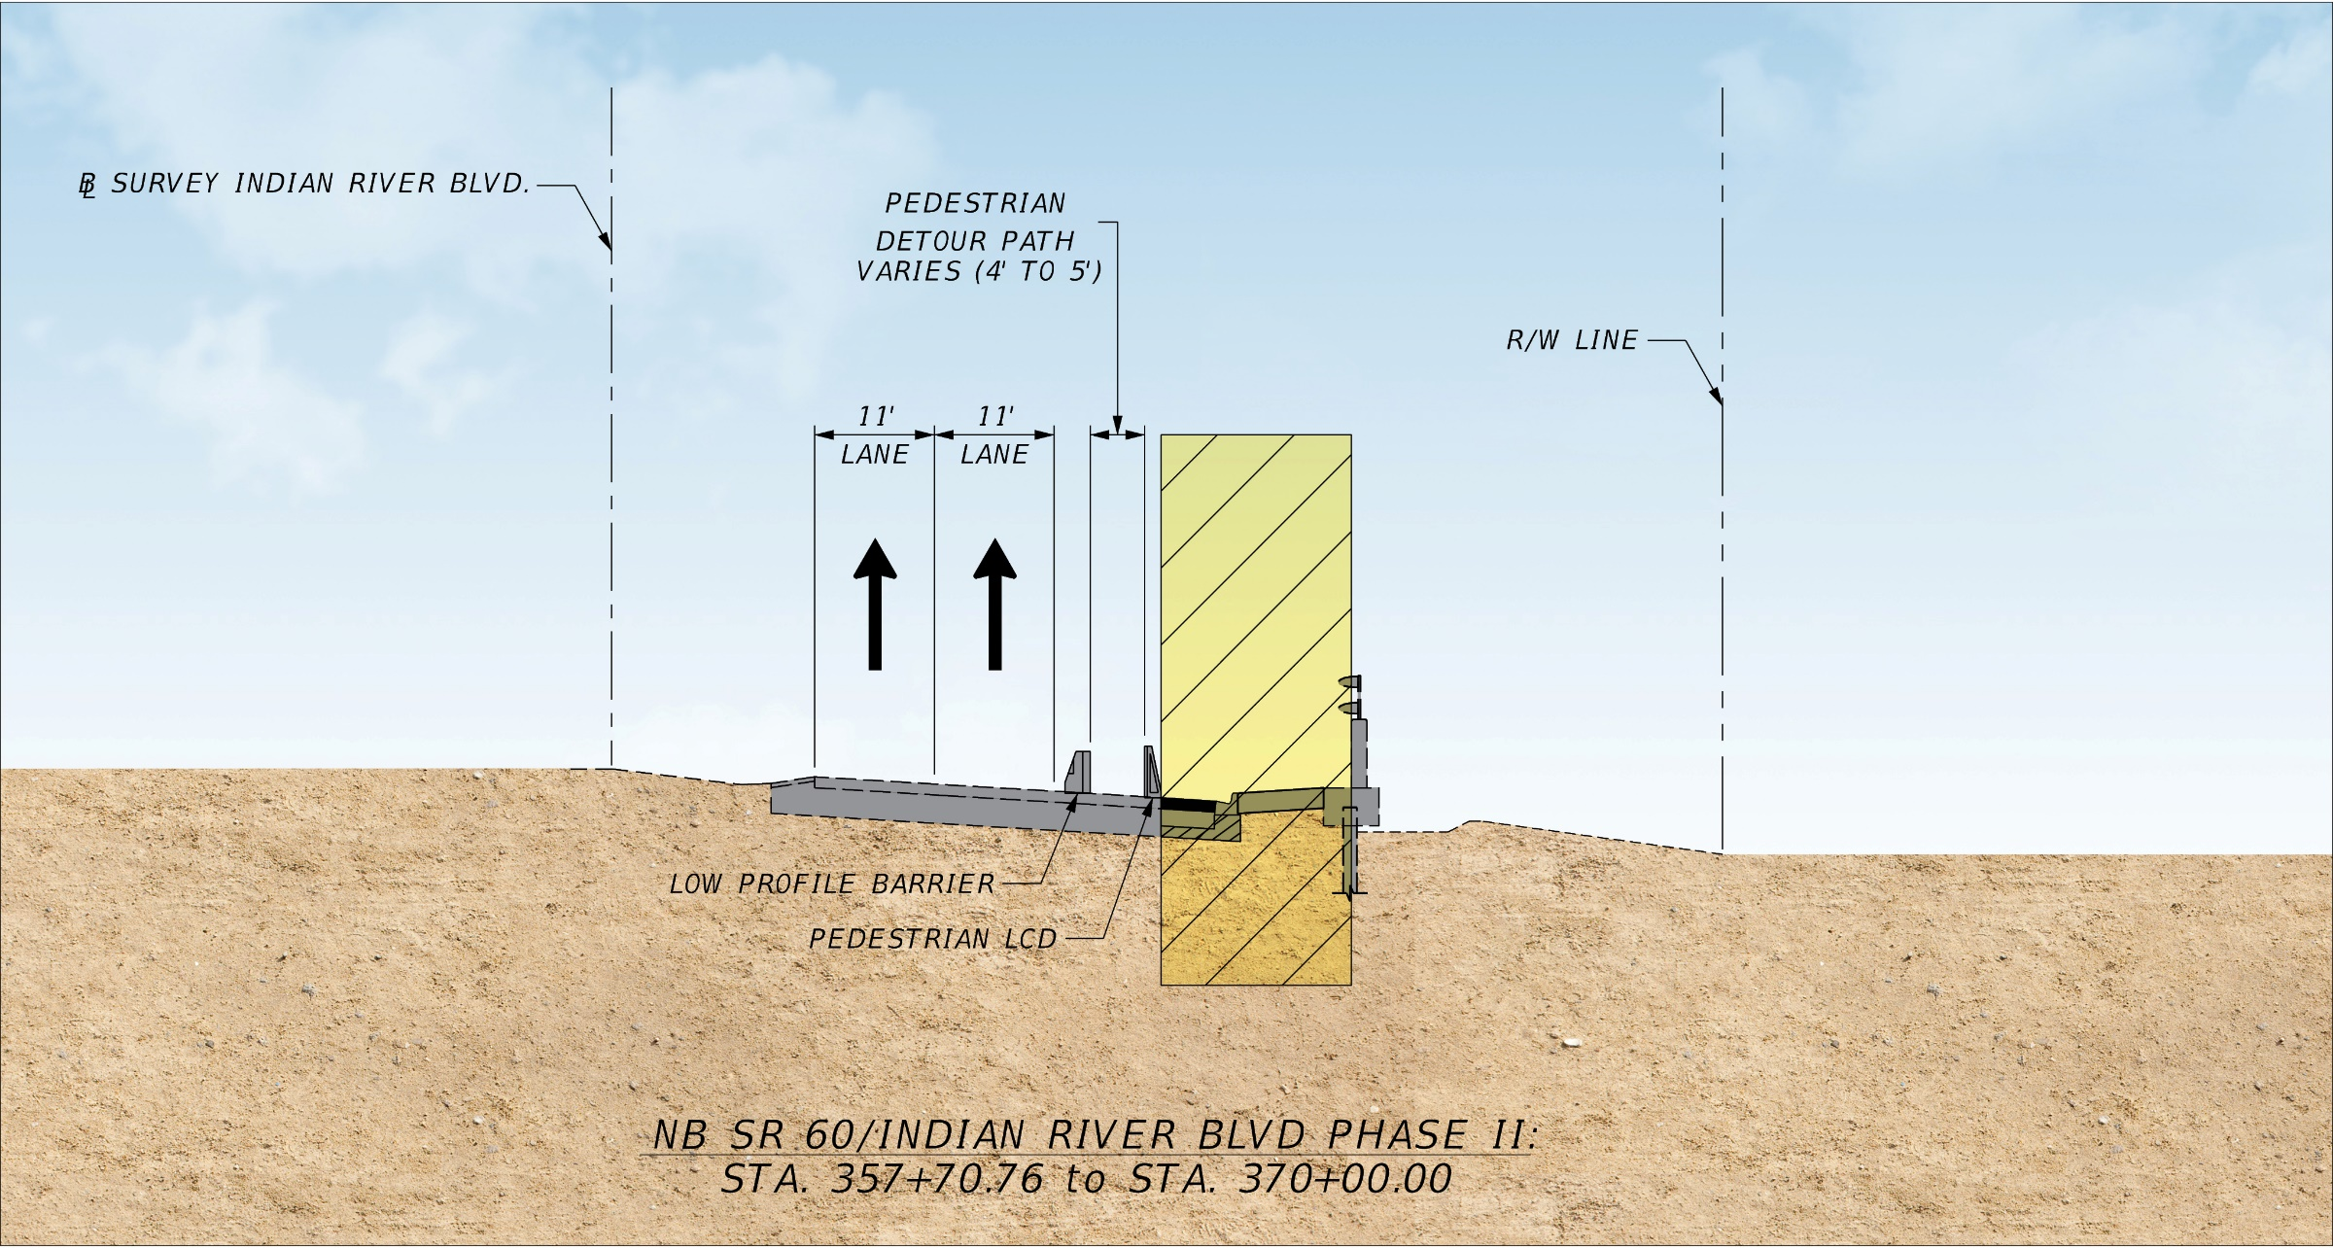
Temporary Traffic Control
Notes:
(Shaun)
Slide 31
On Slide 31 you can see the yellow hatched area which represents the work zone for Phase II. During this Phase there work will involve widening and extending the NB right turn lane. Due to the changes within the work zone, the sidewalk will need to be reconstructed which requires a temporary pedestrian path as shown in the typical. Not shown on the typicals is the work for Phase III which includes the milling and resurfacing, and pavement markings. This work will be done one lane at a time to minimize traffic impacts.
Please turn to the next slide where Kathy Lajo will discuss the Project Schedule and Cost.

Slide 32
Project Design Status
Currently in the Design Phase for the 90% Plans
Several other Projects in the immediate area
Currently working on coordination between construction of this project and other adjacent projects to minimize traffic impacts
Will be back in the near future to present our findings with another Design Public Meeting
32
Notes:
(Kathy)
We are currently in the Design Phase for the 90% Plans
The Department has several other Projects in (both design and construction) the immediate area that we are currently coordinating with in order to minimize traffic impacts during construction
We will be back in the near future with another Design Public Meeting to provide an update on the project base on our coordination
This completes our presentation for the project.
Thank you all for you time.
And now I’ll pass it over to Lauren to start the public comment period.

Slide 33
Questions and Answers
33
Notes:
(Lauren)
Slide 34

Slide 34
Questions and Answers
All in-person attendees are welcome to submit a question or comment by forming a line.
Virtual (online) attendees are welcome to ask a question or provide a comment, by utilizing the question panel or “Raise Hand” button on the GoToWebinar control panel. Once your microphone is unmuted, please provide your full name first and then your question/comment. Your microphone will remain unmuted until the question/comment has been fully addressed
If your question is not responded to during the event, a response will be provided in writing following the Public Meeting.
34
Notes:
(Lauren)
Slide 35
All in-person attendees are welcome to submit a question or comment by forming a line.
Virtual attendees are welcome to ask a question or provide a comment, by utilizing the question panel or “Raise Hand” button on the GoToWebinar control panel. Once your microphone is unmuted, please provide your full name first and then your question or comment. Your microphone will remain unmuted until the question or comment has been fully addressed.
If your question is not responded to during the event, a response will be provided in writing following the Public Meeting.
Are there any Elected Officials in attendance tonight that would like to ask a question or make a comment?
We will now take questions and comments from the audience attending in-person.
(Once in-person is complete) We will now take questions and comments from the audience attending virtually.
(Verify all questions have been answered.)

Slide 35
Closing and Contact Information
35
Notes:
(Lauren)
Slide 36
That concludes the public comment portion of tonight’s meeting. With that, I invite the project manager, Haiyan Ou, back for closing comments.

Slide 36
Contact Information
If you have additional questions, please contact:
Haiyan Ou, P.E. – FDOT Project Manager at:
Haiyan.Ou@dot.state.fl.us
3400 West Commercial Boulevard
Fort Lauderdale, Florida 33309
(954) 777-4641 or
Toll Free: (866) 336-8435; Ext. 4641
36
Notes:
(Haiyan)
Slide 37
Thank you for attending tonight’s public meeting.
If you have additional questions or comments, please contact me:
By email at: Haiyan.Ou@dot.state.fl.us
By phone at: (954) 777-4641 or toll-free at (866) 336-8435; Ext. 4641
Or by sending correspondence to 3400 West Commercial Boulevard Fort Lauderdale, Florida 33309 attention Haiyan Ou

Slide 37
Safety Message
37
Thank you!
37
Notes:
(Haiyan)
Slide 38
As our meeting comes to an end, the Florida Department of Transportation would like to take this time to remind you to wear a helmet while riding!

